Slide 1



Hamiltonian Simulation
An overview
Jacob Watkins
FRIB-TA Summer School 2022

Slide 2
Recap
Basics of quantum computing (morning)
Afternoon: Quantum dynamics
Hamiltonian simulation
Phase estimation (phase ➞ eigenvalue)
Adiabatic evolution (state preparation, ground state determination)
Next hour: a deeper dive into Hamiltonian simulation (HS)

Slide 3
By the end of this talk…
You should be able to
Define Hamiltonian simulation (in the context of quantum computing)
Recognize the scope and limitations of quantum simulations
Understand the phrase ”k-local Hamitonian simulation is BQP-complete”

Slide 4
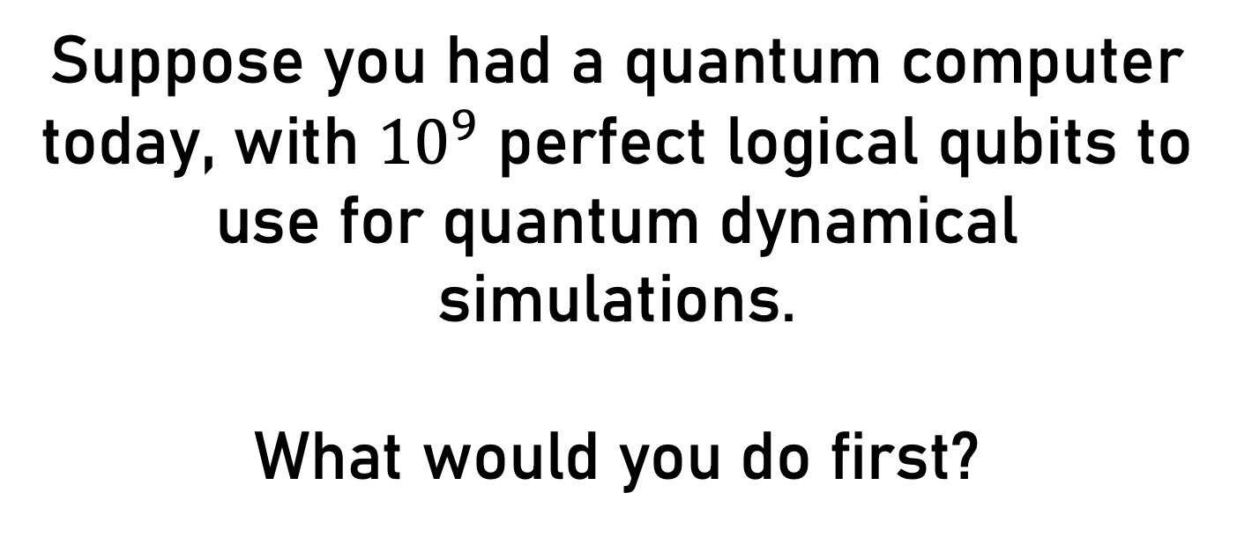
Suppose you had a quantum computer today, with ${10}^{9}$ perfect logical qubits to use for quantum dynamical simulations.
What would you do first?

Slide 5
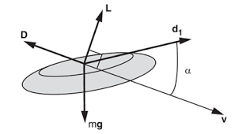
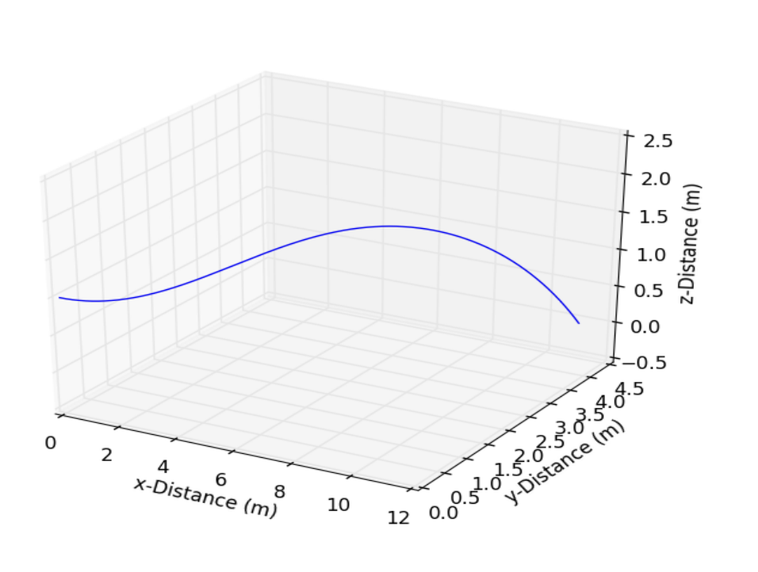
Why care about dynamical sims?
Gets to the basic goals of physics and science!
Concrete predictions + Empirical verification = Confidence in theory
Leads to new phenomena not obvious from basic theory. (e.g. phase transitions)
Hubbard & Hummel, 2000.
Hannah, 2017.

Slide 6
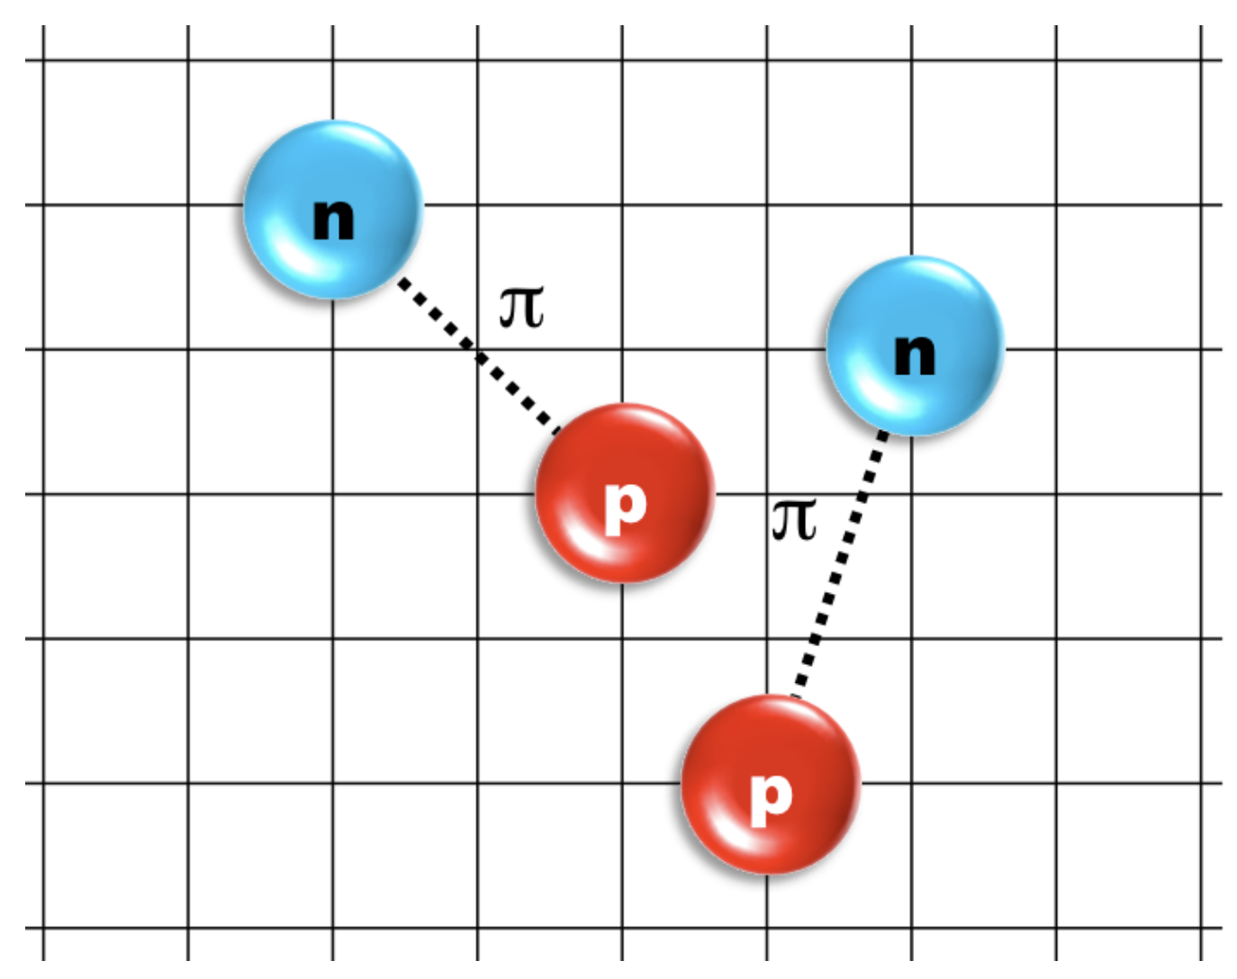
Why care about Hamiltonian simulation (HS)?
A significant fraction of computing power is currently dedicated to simulating quantum systems (many of you know this well!)
HS algs are promising first (useful) app of quantum computers
Lattice EFT principle, courtesy of Dean Lee

Slide 7
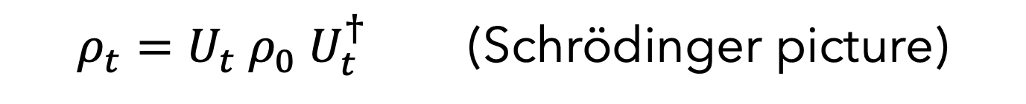
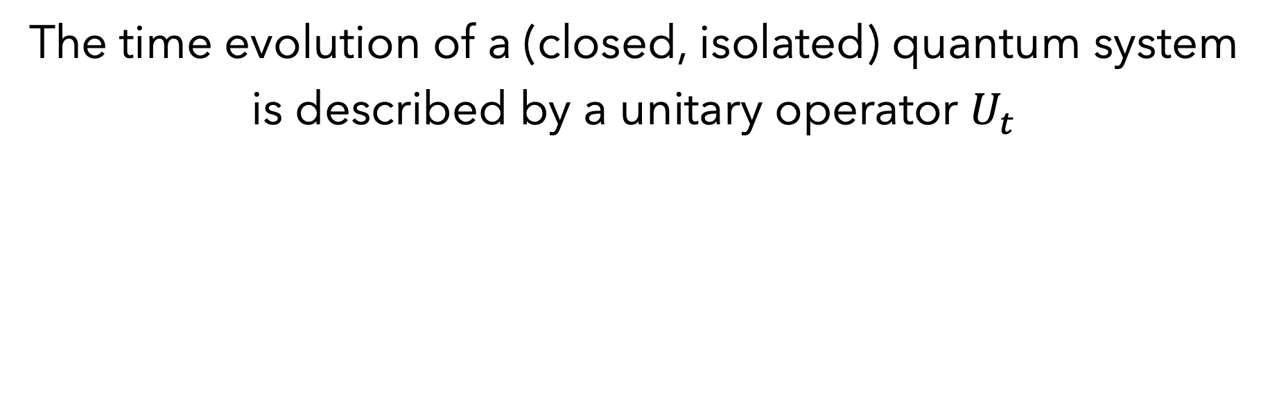
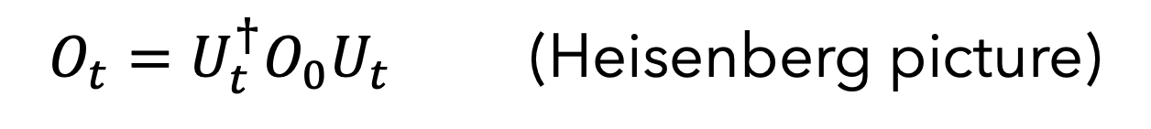
Quantum dynamics
The time evolution of a (closed, isolated) quantum system is described by a unitary operator $U_{t}$
$ρ_{t}=U_{t} ρ_{0} U_{t}^{†}$ (Schrödinger picture)
$O_{t}=U_{t}^{†}O_{0}U_{t}$ (Heisenberg picture)

Slide 8
From Unitaries to Hamiltonians
(to the white board)

Slide 9
Can you think of reasons why you might prefer a classical simulation over a quantum one?

Slide 10

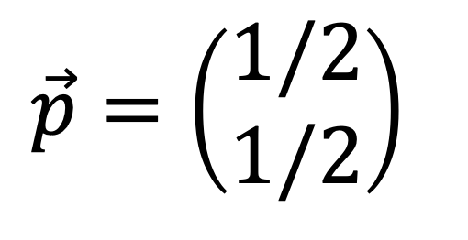
Representing quantum objects
$$\vec{p}=\left(\begin{matrix}1/2 \\ 1/2\end{matrix}\right)$$

Slide 11
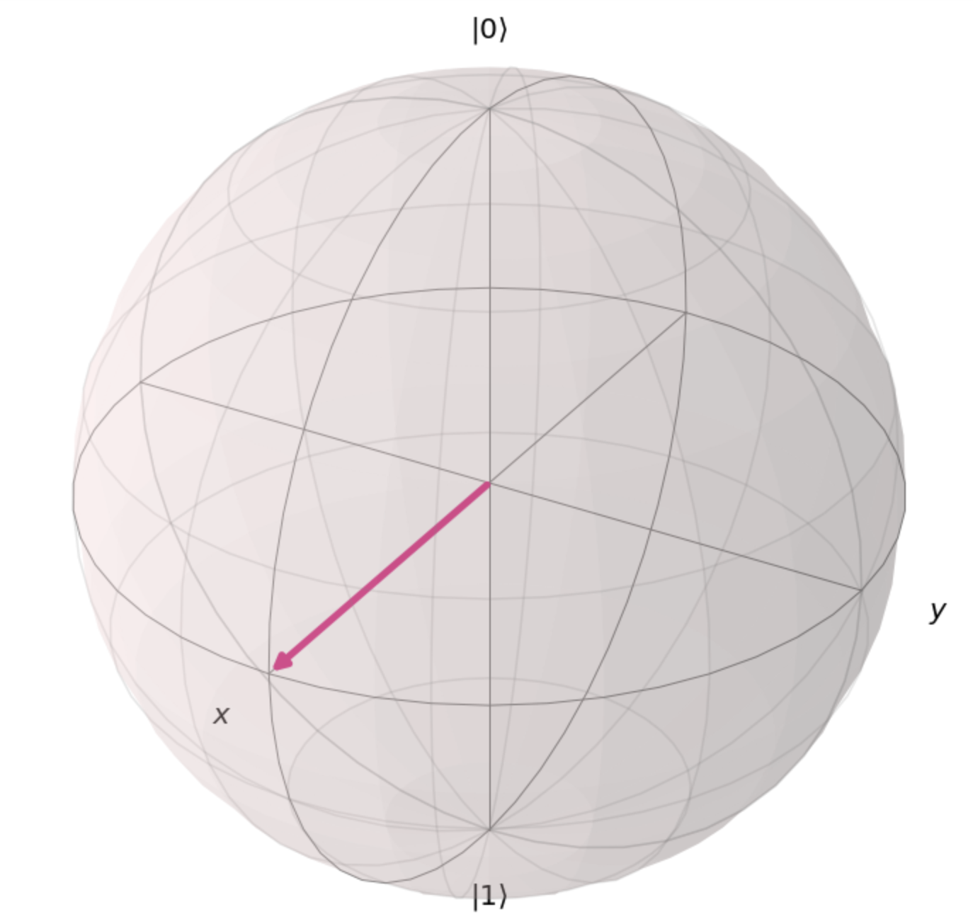
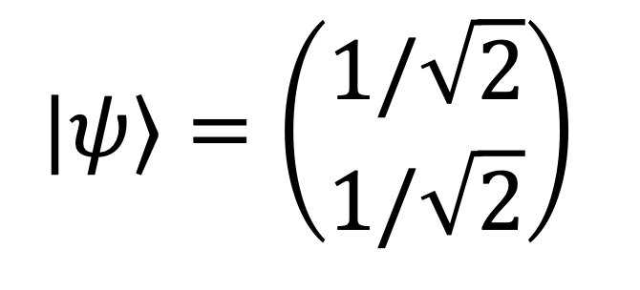
Representing quantum objects
$$|ψ⟩=\left(\begin{matrix}1/\sqrt{2} \\ 1/\sqrt{2}\end{matrix}\right)$$

Slide 12
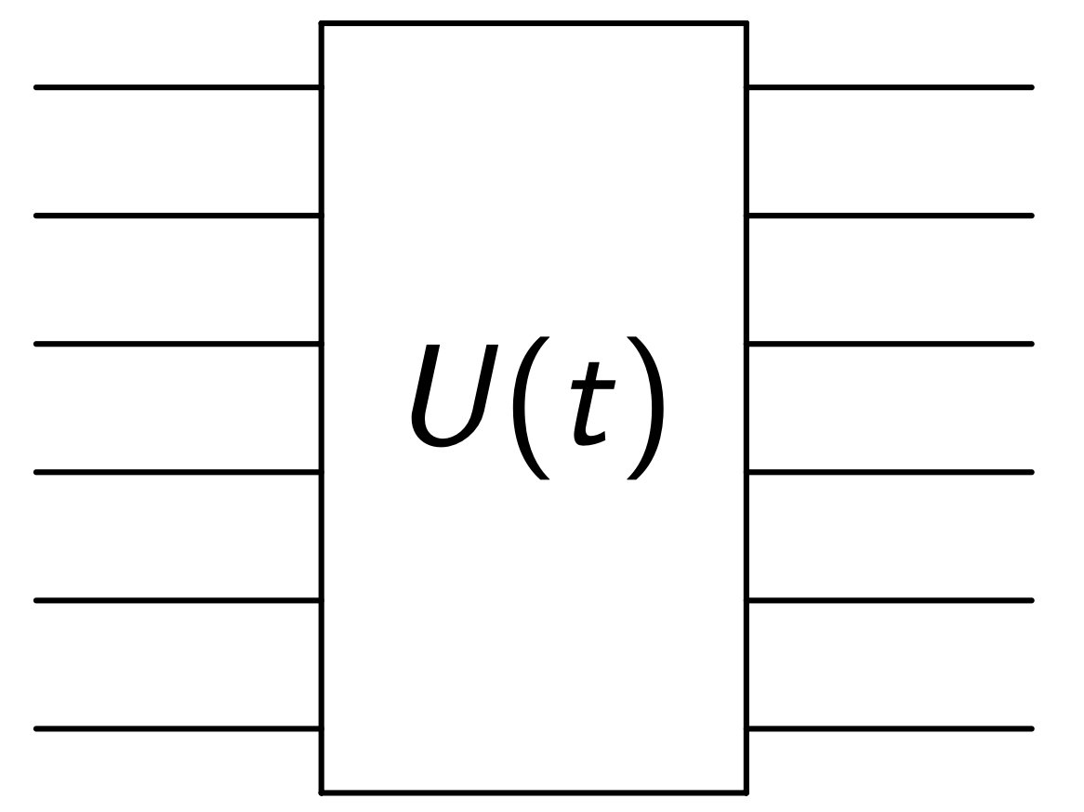
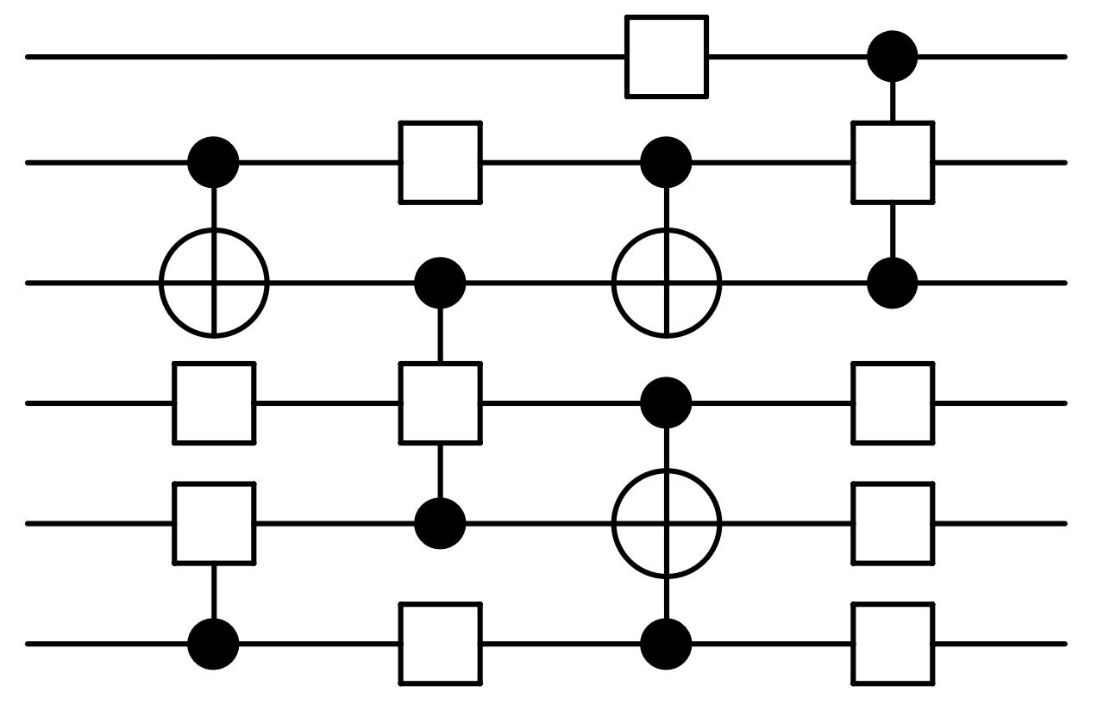
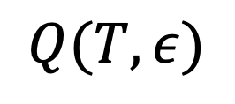

Towards a formal definition.
Given a Hamiltonian H, simulation time T, construct a quantum circuit Q which approximates U to accuracy $ε$.
$$≈$$
$$Q(T, ε)$$

Slide 13
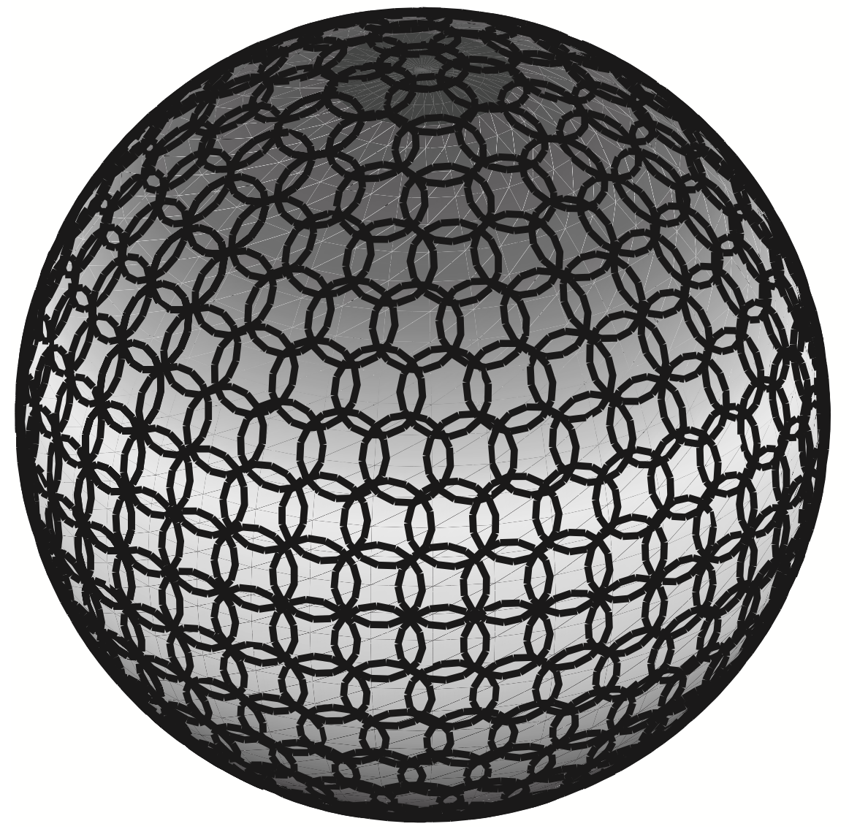
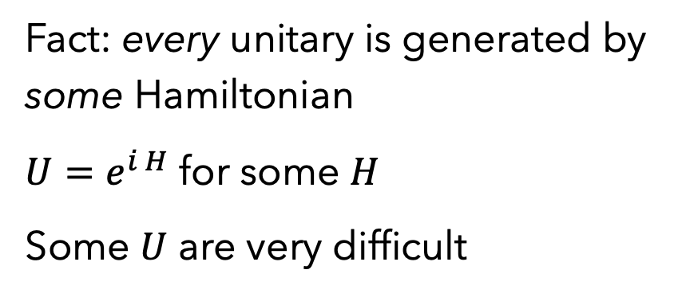

How hard is simulating $U$? Really hard.
Fact: every unitary is generated by some Hamiltonian
$U=e^{i H}$ for some $H$
Some $U$ are very difficult
Counting argument for inefficiency of arbitrary U
Nielsen and Chuang, Ch. 4.5.4

Slide 14
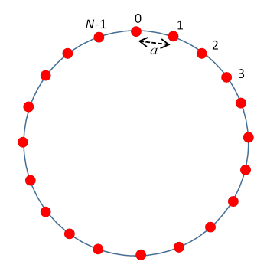
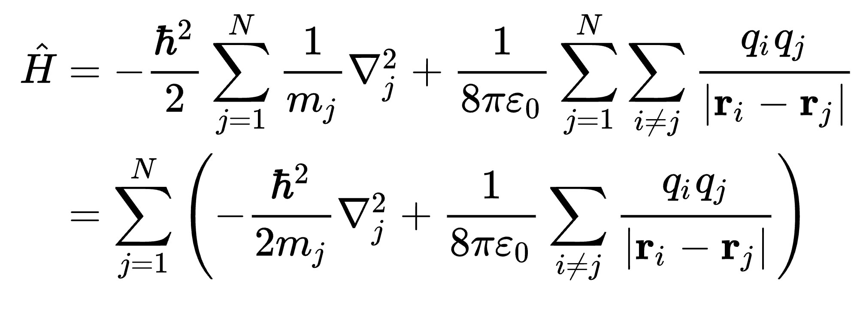
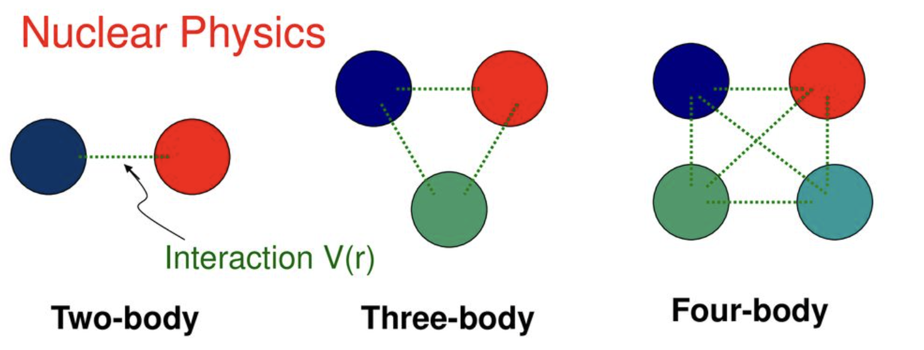
Are physical Hamiltonians arbitrary?
1-body
2-body
Linear chain (or other lattices)
E. Hiyama, RIKEN, https://slideplayer.com/slide/12920762/

Slide 15
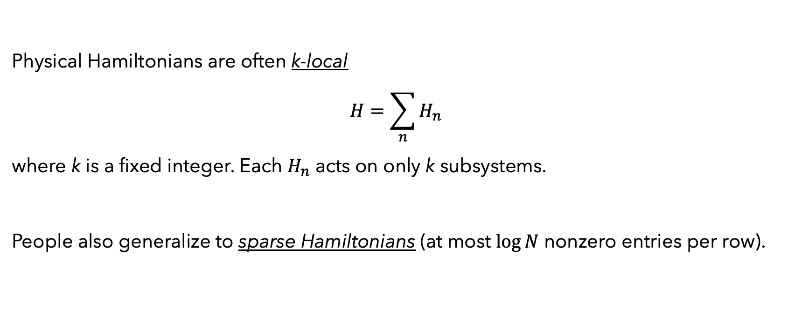
Lesson: “Divide and conquer”
Physical Hamiltonians are often k-local
$$H=\sum_{n}{H_{n}}$$
where k is a fixed integer. Each $H_{n}$ acts on only k subsystems.
People also generalize to sparse Hamiltonians (at most $\log{N}$ nonzero entries per row).

Slide 16
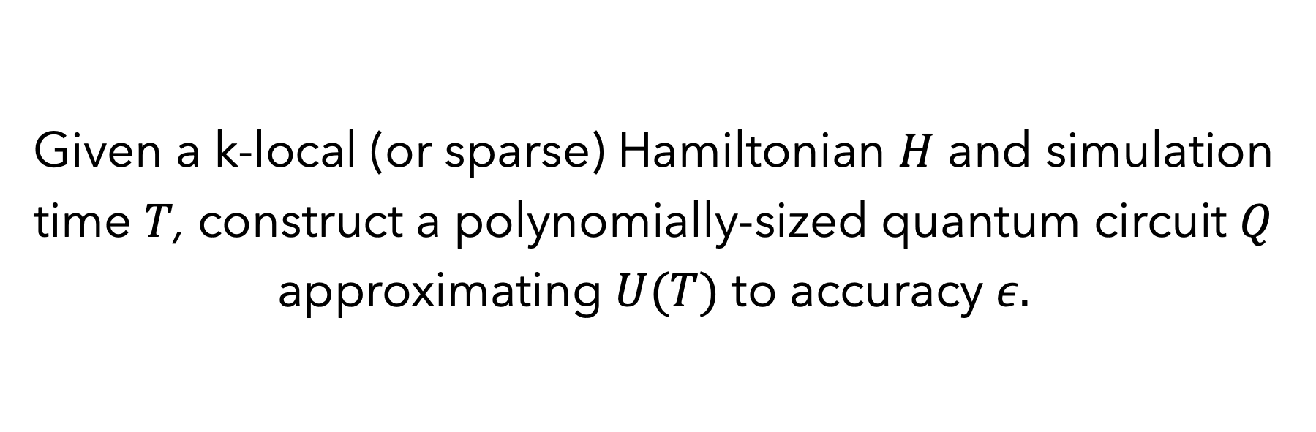
An improved definition of Ham sim
Given a k-local (or sparse) Hamiltonian $H$ and simulation time $T$, construct a polynomially-sized quantum circuit $Q$ approximating $U(T)$ to accuracy $ε.$

Slide 17
How hard is k-local Hamiltonian simulation?

Slide 18
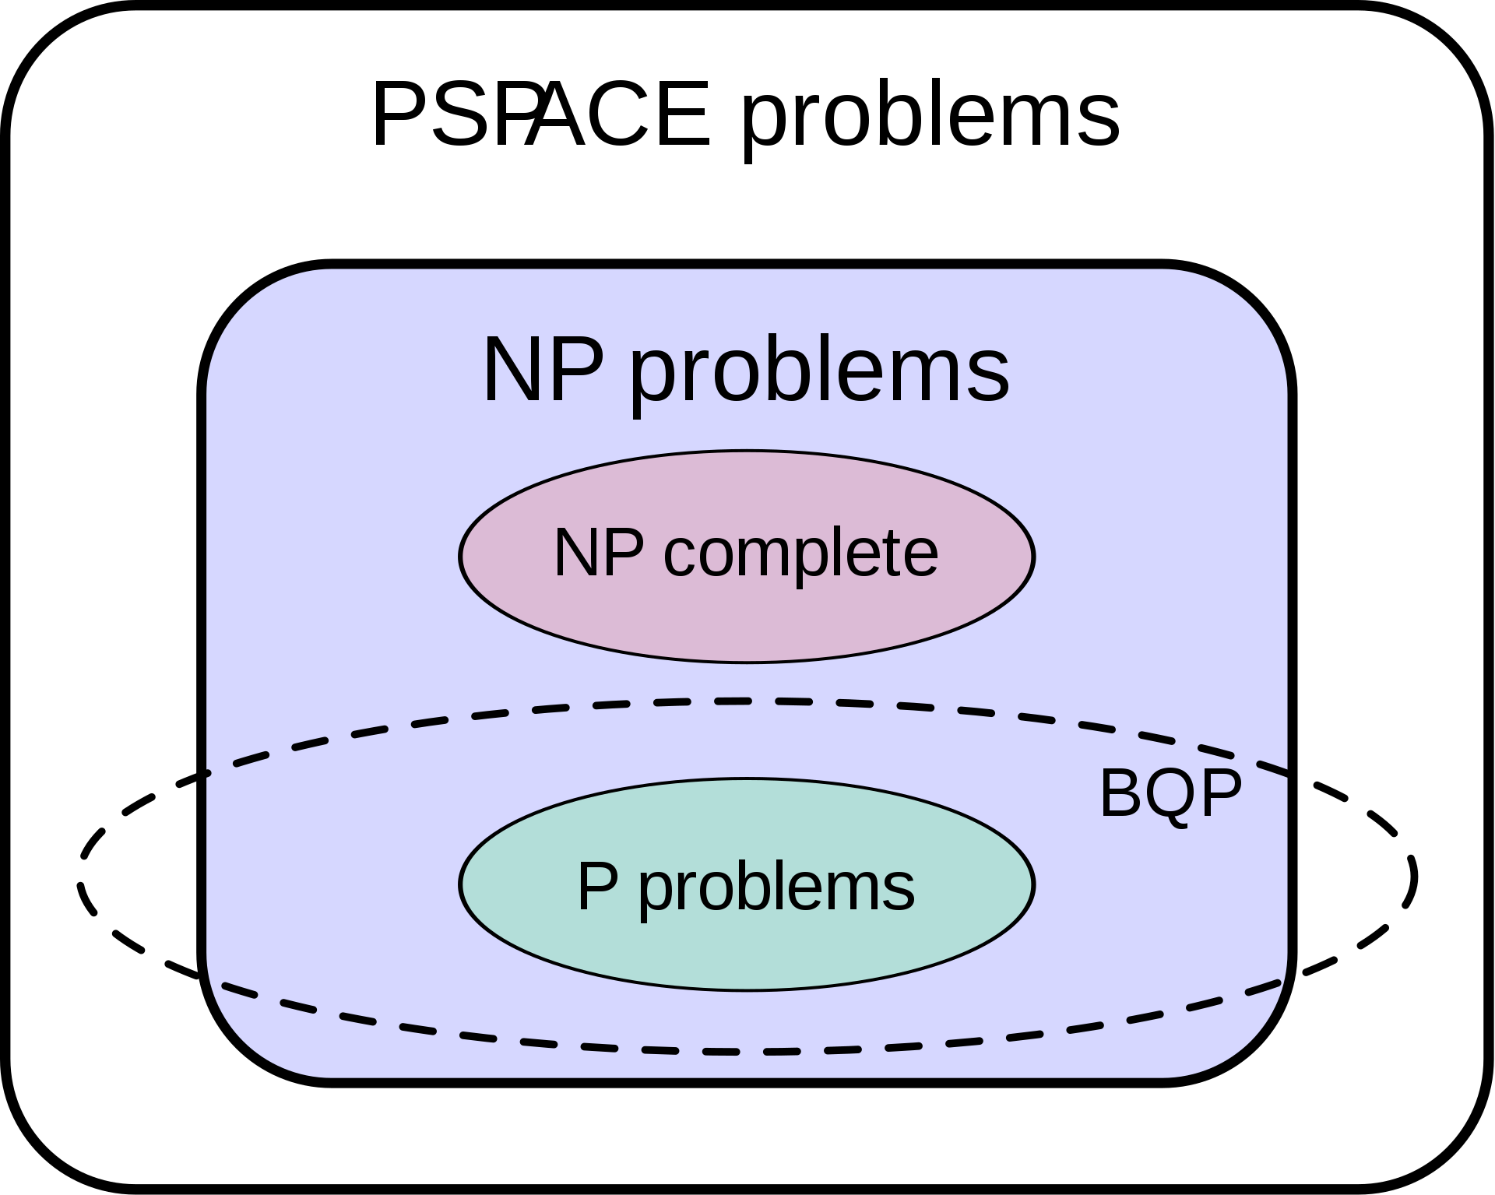
We need a little complexity theory.
P - problems which are efficiently solvable with deterministic computers (adding two numbers, linear programming, primality testing)
BPP - problems efficiently solvable with Monte Carlo methods
BQP – problems solvable with polynomially sized quantum circuit. (factoring, discrete log, Ham sim)
By Mike1024, Wikipedia, BQP

Slide 19
More on BQP
BQP – problems solvable with polynomially sized quantum circuit.
A problem is BQP-hard if it is at least as hard as any problem in BQP.
(More formally, any problem in BQP can be reduced to the hard problem in polynomial time)
A problem is BQP-complete if it is both in BQP and BQP-hard
(These are the “hardest problems” in BQP. Solving these essentially solves them all)

Slide 20
Hamiltonian simulation is BQP-complete
HS is BQP-Hard: For any quantum circuit, there is a k-local Hamiltonian which simulates that circuit
HS is in BQP: Trotterization (aka product formulas) allow for any Hamiltonian to be efficiently simulated.

Slide 21
In summary
Hamiltonian simulation is an important scientific goal. Quantum computers may be able to help.
“Physical Hamiltonians” admit efficient simulation algorithms on quantum computers.
Hamiltonian simulation and quantum circuits are equivalent. This can be helpful for constructing algorithms.

